Slide 1
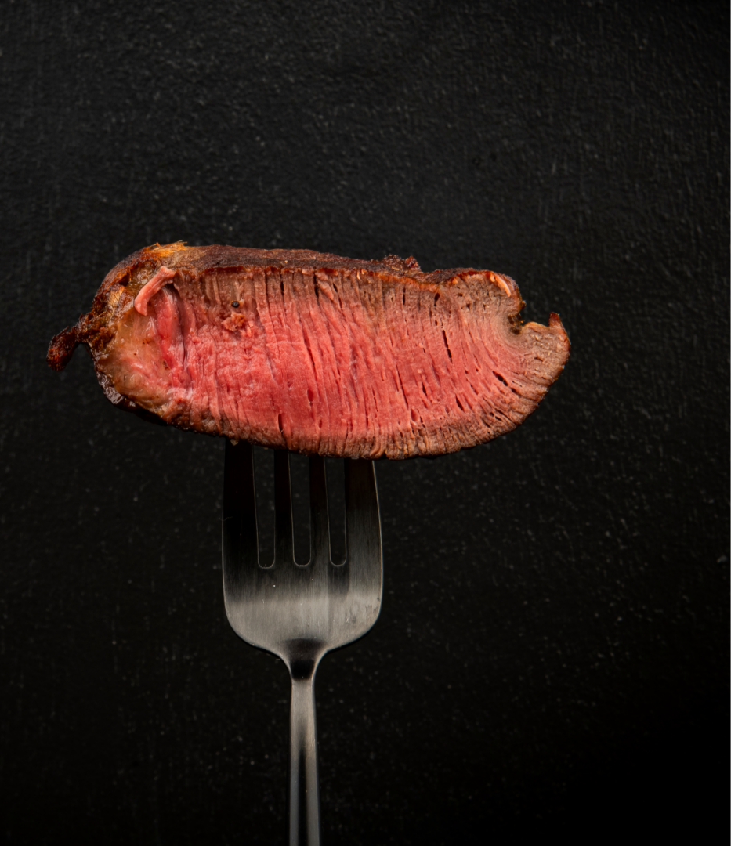

Meat
Consumption
Handong Global University
21800362 Young Kwang Seo
Notes:
Good afternoon Ladies and Gentlemen. Thank you for coming out to listen to me today.
My name is 영광 서 and I am a student at Handong Global University. And today’s topic is meat consumption.

Slide 2

Question & Thesis Statement
Does meat harm human health?
Meat consumption is not good for human health!!
Notes:
So, how many of you like to eat meat? Are you all vegetarians? Well, I like to eat meat. And for those people like me, this question, ‘does meat harm human health?‘ will cause panic.
Unfortunately, meat consumption is not good for human health.
Today, I prepared five main arguments for this thesis statement.

Slide 3
01
Meat consumption increases the risk of cancer.
Notes:
First, meat consumption increases the risk of cancer.

Slide 4
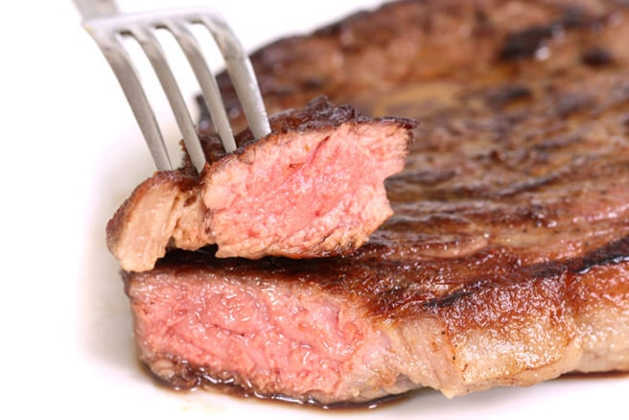
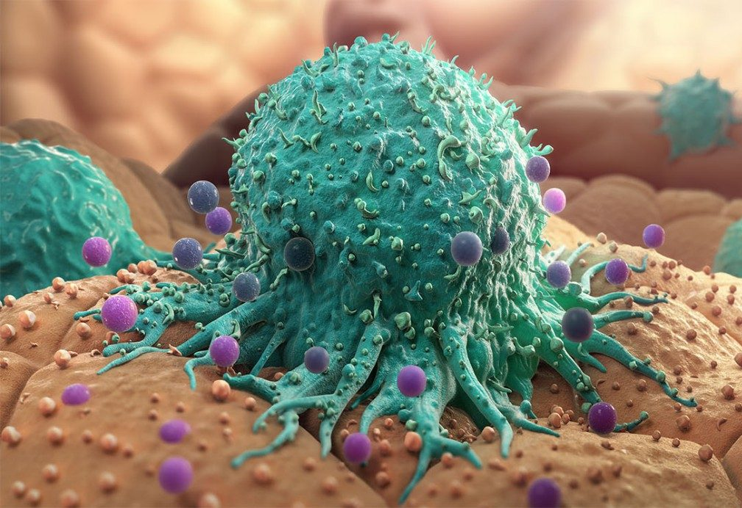
01
Meat consumption increases the risk of cancer.
A clear link has been found between larger intake of red meat and colorectal, lung, esophageal, and gastric cancers (Lippi et al., 2016)
Notes:
As you can see, the picture on the right side is showing a cancer cell.
A clear link has been found between larger intake of red meat and several cancers.

Slide 5
02
Meat consumption is harmful to heart health.
Notes:
Second, unfortunately, meat consumption is also harmful to heart health.

Slide 6
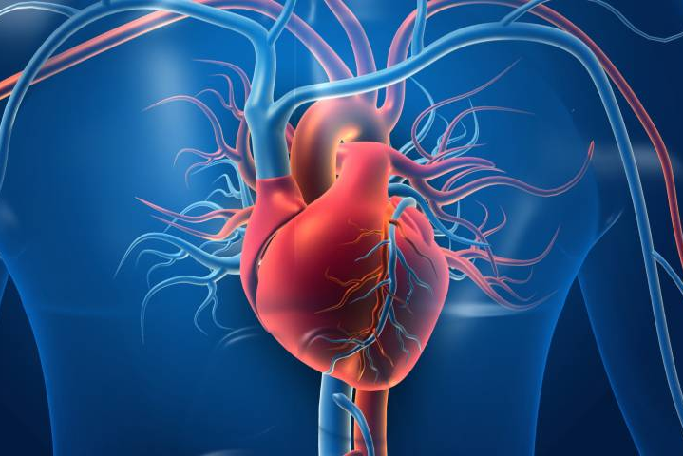
02
Meat consumption is harmful to heart health.
Higher intake of processed meats has been strongly correlated with elevated cholesterol levels and an increased risk of heart disease (Micha et al., 2013).

Slide 7
03
Increased demand for meat leads to the emergence of antibiotic-resistant bacteria.
Notes:
The third shocking fact is that increased demand for meat leads to the emergence of antibiotic-resistant bacteria.
And this certainly makes the situation worse.

Slide 8
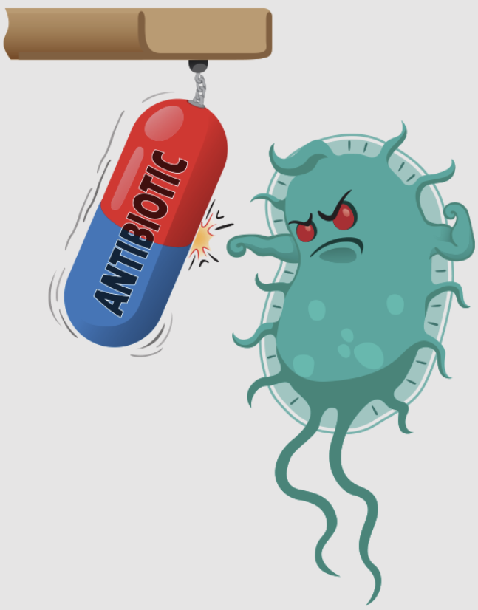
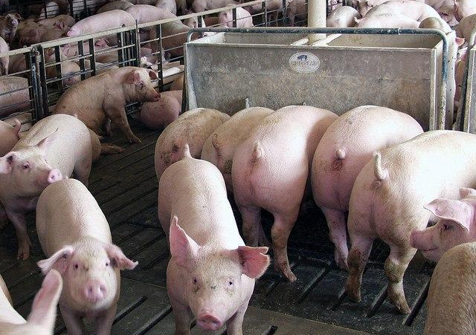
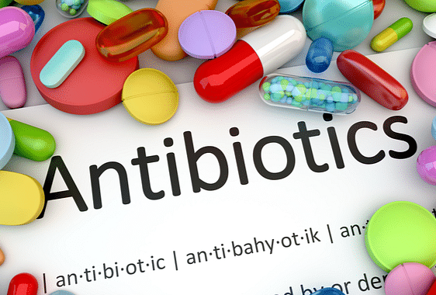
03
Increased demand for meat leads to the emergence of antibiotic-resistant bacteria.
The widespread use of antibiotics in animal agriculture is promoting the emergence of antibiotic-resistant bacteria.

Slide 9
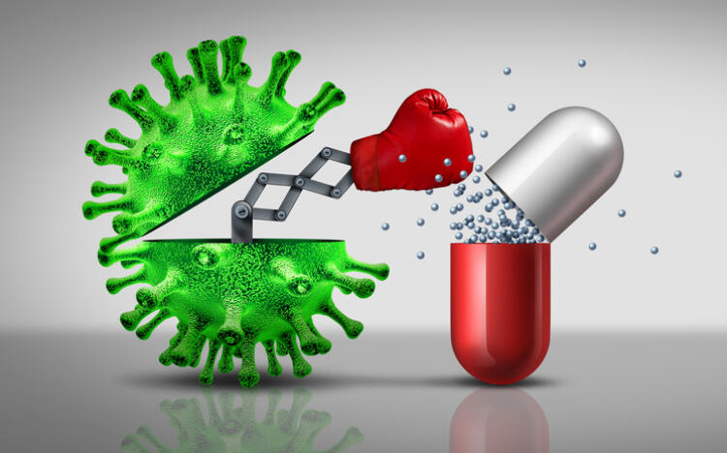
03
Increased demand for meat leads to the emergence of antibiotic-resistant bacteria.
If these resistant strains enter the human ecosystem, the effectiveness of antibiotics to fight human infections gradually weakens.

Slide 10
04
Meat consumption can lead to digestive health complications.
Notes:
Forth, meat consumption can lead to digestive health complications.

Slide 11
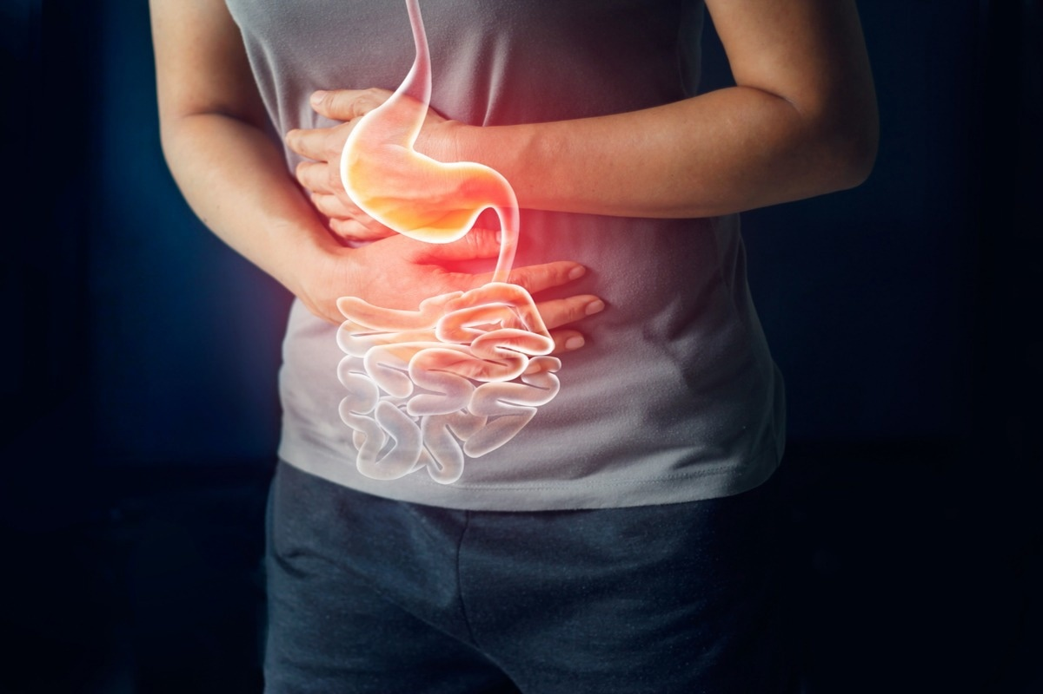
04
Meat consumption can lead to digestive health complications.
Certain compounds, such as heterocyclic amines and polycyclic aromatic hydrocarbons, which are formed during the cooking process of meat, increase the risk of potential digestive disorders, especially colorectal cancer.
Notes:
Certain compounds, which are formed during the cooking process of meat, increase the risk of potential digestive disorders, especially colorectal cancer.
So if you eat too much meat from now on, you will suffer in the bathroom for an hour in the future.

Slide 12
05
Excessive meat consumption can make it challenging to manage the weight.
Notes:
Lastly, it can be obvious but excessive meat consumption can make it challenging to manage the weight.

Slide 13
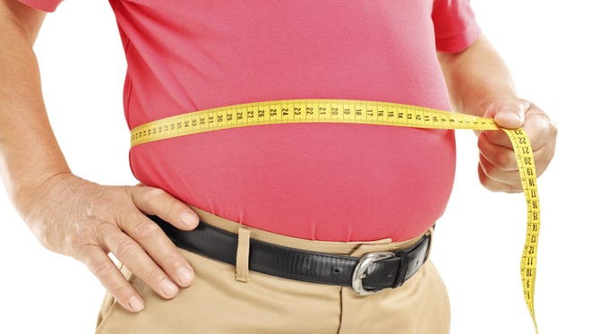
05
Excessive meat consumption can make it challenging to manage the weight.
Excessive consumption of meat is associated with weight gain and obesity due to its high calorie and fat content.

Slide 14
Summary
01
Increased cancer risk
02
Harmful effects on heart health
03
Potential contributions to antibiotic resistance
04
Digestive complications
05
Difficulty managing weight
Notes:
So far, we've covered five reasons why meat is harmful for human health.

Slide 15
Conclusion
While there's no doubt that meat consumption has a negative impact on our health, there are also studies that show that moderate meat consumption can have a positive impact on our health.
It is important to avoid excessive meat consumption to maintain good health.
Notes:
In conclusion Ladies and Gentlemen, while there's no doubt that meat consumption has a negative impact on our health, there are also studies that show that moderate meat consumption can have a positive impact on our health.
So it is important to avoid excessive meat consumption to maintain good health.

Slide 16
Reference List
Heavey, P. M., McKenna, D., & Rowland, I. R. (2004). Colorectal cancer and the relationship between genes and the environment. Nutrition and Cancer, 48(2), 124-141.
Helmus, D. S., Thompson, C. L., Zelenskiy, S., Tucker, T. C., & Li, L. (2013). Red meat-derived heterocyclic amines increase risk of colon cancer: a population-based case-control study. Nutrition and Cancer, 65(8), 1141-1150.
Kim, E., Coelho, D., & Blachier, F. (2013). Review of the association between meat consumption and risk of colorectal cancer. Nutrition Research, 33(12), 983-994.
Lippi, G., Mattiuzzi, C., & Cervellin, G. (2016). Meat consumption and cancer risk: a critical review of published meta-analyses. Critical Reviews in Oncology/Hematology, 97, 1-14.
Micha, R., Michas, G., Lajous, M., & Mozaffarian, D. (2013). Processing of meats and cardiovascular risk: time to focus on preservatives. BMC Medicine, 11, 1-4.
Serwecińska, L. (2020). Antimicrobials and antibiotic-resistant bacteria: a risk to the environment and to public health. Water, 12(12), 3313.
Notes:
This is my reference list.

Slide 17
Q & A
Notes:
Is there any question?

Slide 18
Thank You
Notes:
Ladies and Gentlemen, I appreciate you listening to my presentation today. Thank you!

